Slide 1
HealthCare Analysis

Slide 2
Introduction
The provided healthcare dataset includes comprehensive data on funding for various research and disease areas from 2008 to 2024, as well as mortality and prevalence data for 2019.The objective of this project is to create an extensive Tableau dashboard based on the provided dataset.
The dashboard will include various types of visualizations, analytical techniques, and features. This will demonstrate different functionalities in Tableau, such as joins, custom SQL, filters, and advanced calculations.
This project will showcase my ability to leverage Tableau’s full range of functionalities to present complex healthcare data in an accessible, actionable way.

Slide 3
Methodologies
Data Preparation
Cleaned and structured data from the provided Excel sheets (RCDC & Summary datasets).
Missing values, duplicates, and non-numeric inconsistencies were handled.
Pivoted Standardized year-based funding columns (2008–2024).
Integrated 2019 mortality and prevalence data with corresponding disease research areas.
Converted data types ensured funding columns were numeric, years were chronological, and text labels were consistent.
Combined all visuals into a cohesive, user-friendly dashboard.
Added filters, parameters, actions, and tooltips for interactive exploration.
Ensured clarity through color-coding, legends, and consistent formatting.
Final dashboard allowed users to:
Compare multiple diseases
Analyze funding effectiveness
Predict future trends interactively

Slide 4
Visualization and Dashboard Development
Developed multiple visualization types to answer key analytical questions:
Line Graphs show funding trends over time.
Dual Line Graphs compare two research areas.
Bar Charts (Side by side, Stacked) compare funding distribution.
Pie and Doughnut Charts show funding proportion.
Gantt Chart represents the funding timeline.
Scatter Plot correlates funding with other factors like mortality or prevalence.
Tree and Heat Maps visualize hierarchical data and intensity levels.
Maps (Symbol and Filled) perform geographic analysis of funding.
Waterfall and Whisker Charts show funding variation, increments, and ranges over time.

Slide 5
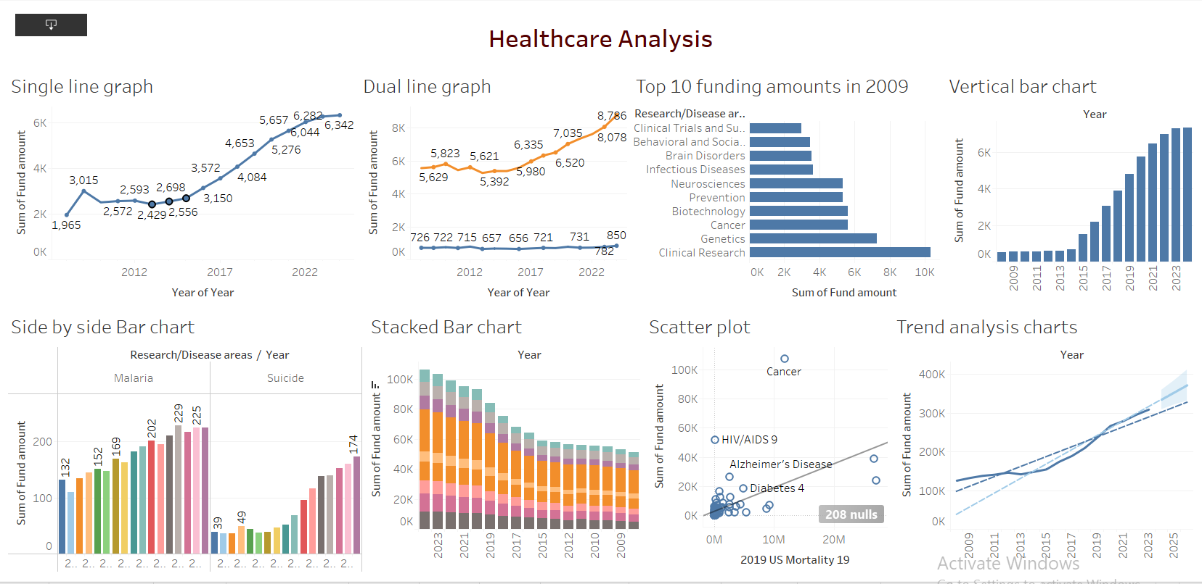

Slide 6
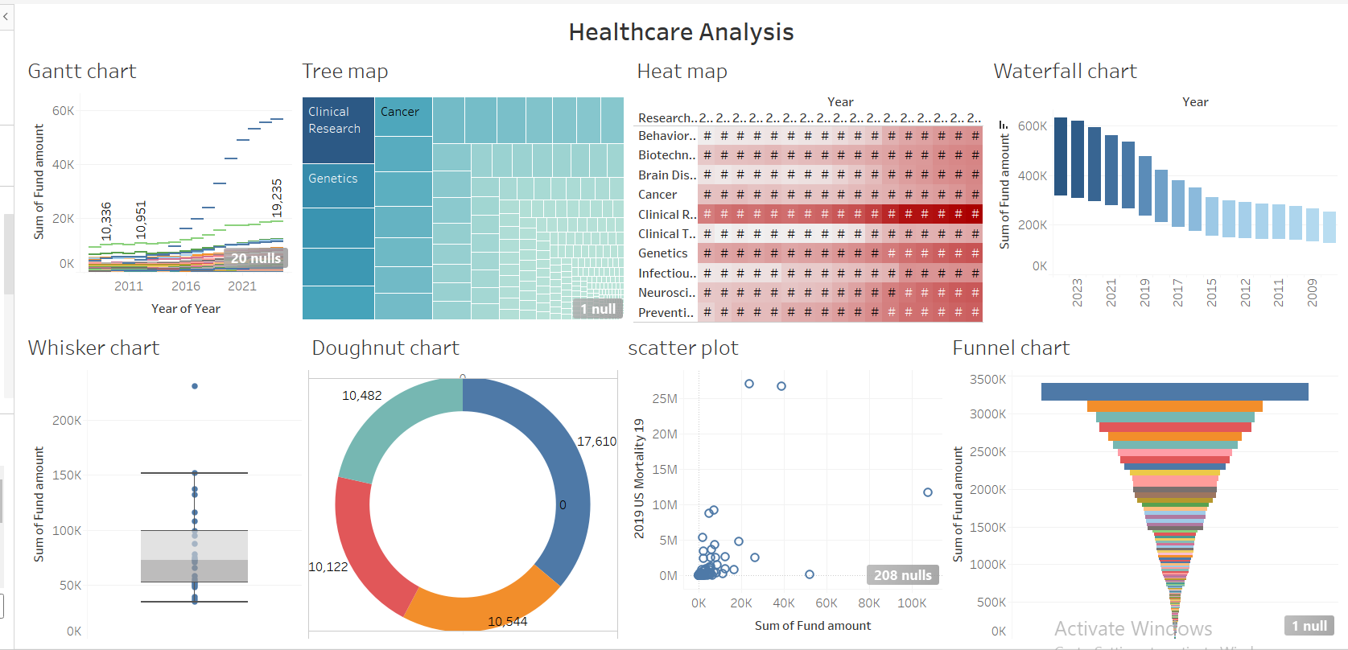

Slide 7
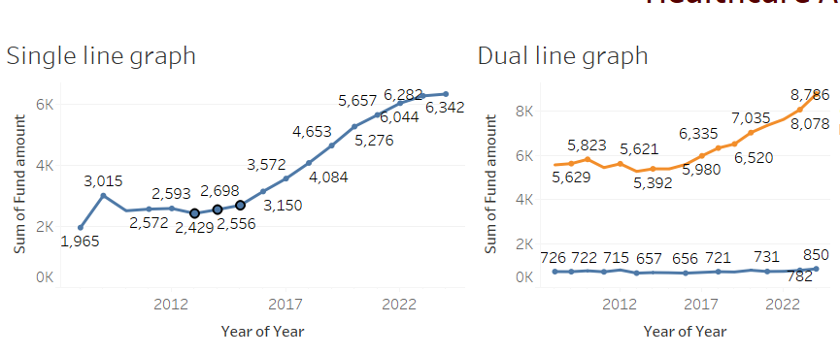
Key Findings
1. Consistent Funding Growth in Major Research Areas
Finding:
From 2008 to 2024, total healthcare research funding shows steady growth, with Cancer, Cardiovascular, and Neurological Diseases receiving the largest and most consistent allocations.
Insight:
Indicates strong long-term national focus on high-mortality and chronic diseases.
Visualization Used:
Single Line Graph – displays year-wise funding trend for individual research areas.
Dual Line Graph – compares growth trends between two top-funded disease areas (e.g., Cancer vs. Cardiovascular).

Slide 8
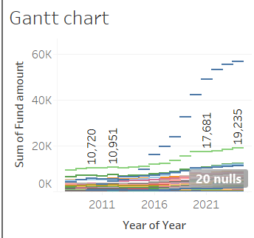
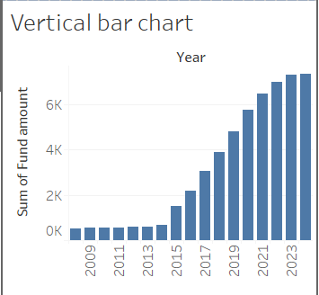
2. Significant Impact of ARRA (American Recovery and Reinvestment Act) Funding (2009–2011)
Finding:
A significant spike in funding during the ARRA period (2009–2011), especially in Cancer, Mental Health, and Diabetes research.
Insight:
Demonstrates the effectiveness of government stimulus programs in accelerating scientific funding and research output.
Visualization Used:
Gantt Chart – highlights ARRA-funded periods across different research areas.
Vertical Bar Chart – shows comparative funding before, during, and after ARRA

Slide 9
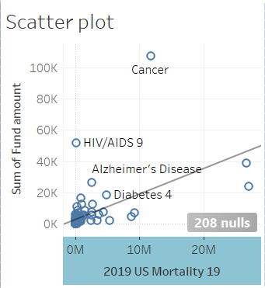
3. Correlation Between Funding and Health Outcomes (2019 Mortality & Prevalence)
Finding:
Research areas with higher funding (e.g., Cardiovascular) exhibit lower mortality rates.
Areas like Mental Health and Obesity have high prevalence but low funding.
Insight:
Suggests a funding–outcome gap, emphasizing the need for better alignment of resources with disease burden.
Visualization Used:
Scatter Plot – plots 2019 funding against mortality and prevalence rates to reveal correlations

Slide 10
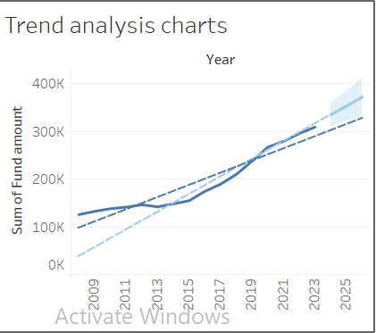
4. Emerging Research Trends and Future Funding Focus (2022–2024 projections)
Finding:
Forecasted data shows increasing investment in Genetics, Neuroscience, and Public Health — indicating a strategic shift toward precision medicine and data-driven healthcare.
Insight:
Predictive analysis highlights the evolution of national research focus toward innovation-based fields.
Visualization Used:
Trend Line Analysis (Linear, Exponential, and Polynomial Models) – projects future funding trends.

Slide 11
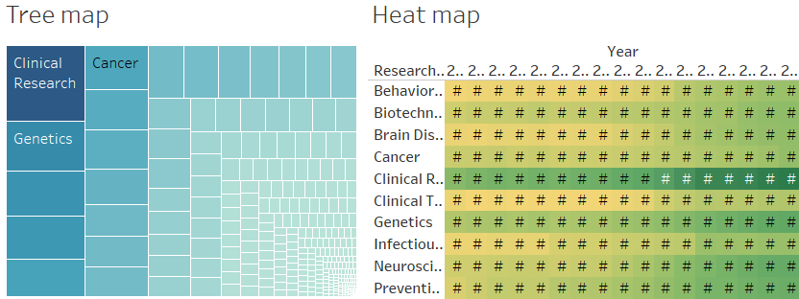
6. Funding Diversity and Hierarchical Distribution
Finding:
Approximately 60–70% of total funding is concentrated in a few dominant areas, while smaller research fields receive lower but consistent support.
Insight:
Suggests a core–peripheral structure in funding priorities: few areas dominate, while many sustain baseline research activity.
Visualization Used:
Tree Map – shows hierarchical structure of funding.
Heat Map – highlights funding intensity across all disease categories.

Slide 12
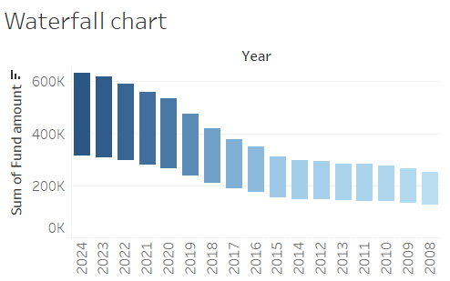
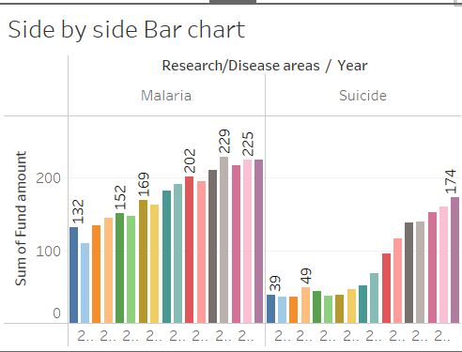
7.Trend Stability and Volatility
Finding:
Stable Funding Areas: Cancer and Cardiovascular Diseases — gradual year-on-year increase.
Volatile Areas: Mental Health, Neurological, and Infectious Diseases strong fluctuations due to public health events and policy changes.
Insight:
Indicates that external factors (pandemics, awareness programs, and political focus) directly affect research investment trends.
Visualization Used:
Side-by-Side Bar Chart – compares annual funding variability between two disease areas.
Waterfall Chart – visualizes year-to-year incremental funding changes.

Slide 13
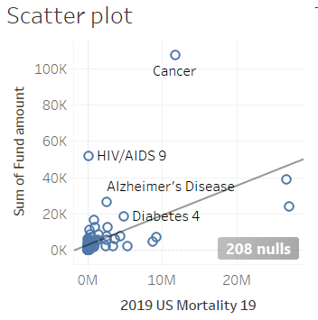
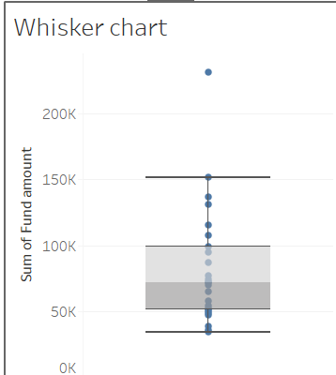
8. Relationship Between Research Area and Mortality Reduction
Finding:
A negative correlation is observed between funding and mortality rate — as funding increases, mortality generally declines in high-funded research areas.
Insight:
Confirms that sustained research investment leads to measurable public health improvements.
Visualization Used:
Scatter Plot – correlation between cumulative funding and mortality rate.
Whisker Plot – shows range (min–max) of funding variation linked to mortality outcomes.

Slide 14
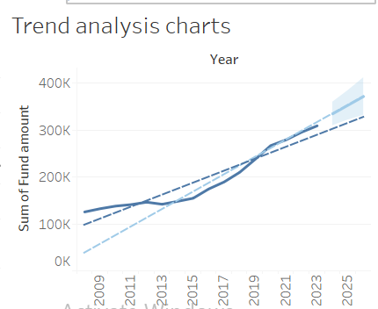
9. Forecasting Insights (Based on Trend Models)
Finding:
Predictive analysis indicates:
10–15% overall funding growth expected by 2025.
Continued rise in AI, genetics, and preventive medicine research.
Insight:
Establishes forward-looking funding potential for emerging medical technologies.
Visualization Used:
Trend Charts (Polynomial and Exponential Models) – visualize projected funding growth trajectories.

Slide 15
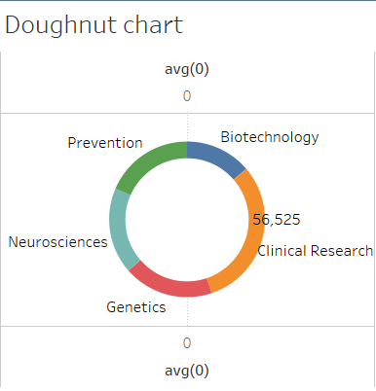
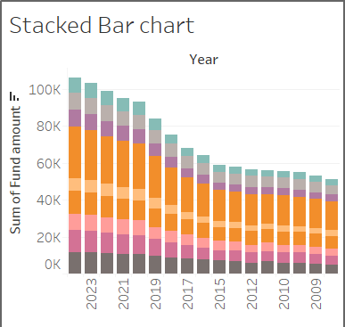
10. Strategic Implications
Finding:
Some high-prevalence diseases (e.g., obesity, mental health) remain underfunded.
Regional and categorical funding gaps persist.
Insight:
Policy redesign should focus on balancing funding equity and enhancing outcome-based funding mechanisms.
Visualization Used:
Stacked Bar Chart – compares proportional funding across disease groups and years.
Doughnut Chart – shows annual funding distribution across major research areas.

Slide 16
Insights
Cancer, Cardiovascular, and Neurological research areas receive consistent and steadily increasing funding from 2008–2024.
ARRA (2009–2011) significantly boosted funding levels across multiple research categories, with lasting post-policy impact.
Funding allocation does not fully align with disease burden high prevalence diseases like Mental Health and Obesity remain underfunded.
There is a negative correlation between funding levels and mortality rates higher investment areas generally show reduced mortality.
Research funding is heavily concentrated in the Northeast U.S., highlighting regional inequality in resource distribution.

Slide 17
Predictive analysis suggests overall healthcare research funding will grow by 10–15% by 2025.
Technological and data-driven research areas are emerging as new funding priorities.
Disparities persist between funding allocation and public health needs, indicating a need for better policy alignment.
Regional funding gaps can be addressed by diversifying investment beyond traditional research hubs.
Outcome-linked funding strategies can improve efficiency and accountability in research spending.
Sustained funding has shown measurable positive impacts on reducing mortality rates in major disease categories.
Long-term trends reveal a gradual shift from traditional biomedical research toward innovation-based and preventive health fields.

Slide 18
Conclusion
The dataset underscores the vital link between research funding and national health priorities.
Sustained investments in certain diseases have yielded measurable health benefits, while others remain underfunded relative to their societal burden.
Data-driven policy design using tools like Tableau enables better resource planning, transparency, and accountability.
The interactive dashboard serves as a decision-support system for stakeholders to track, analyze, and predict healthcare research investments effectively.

